Slide 1
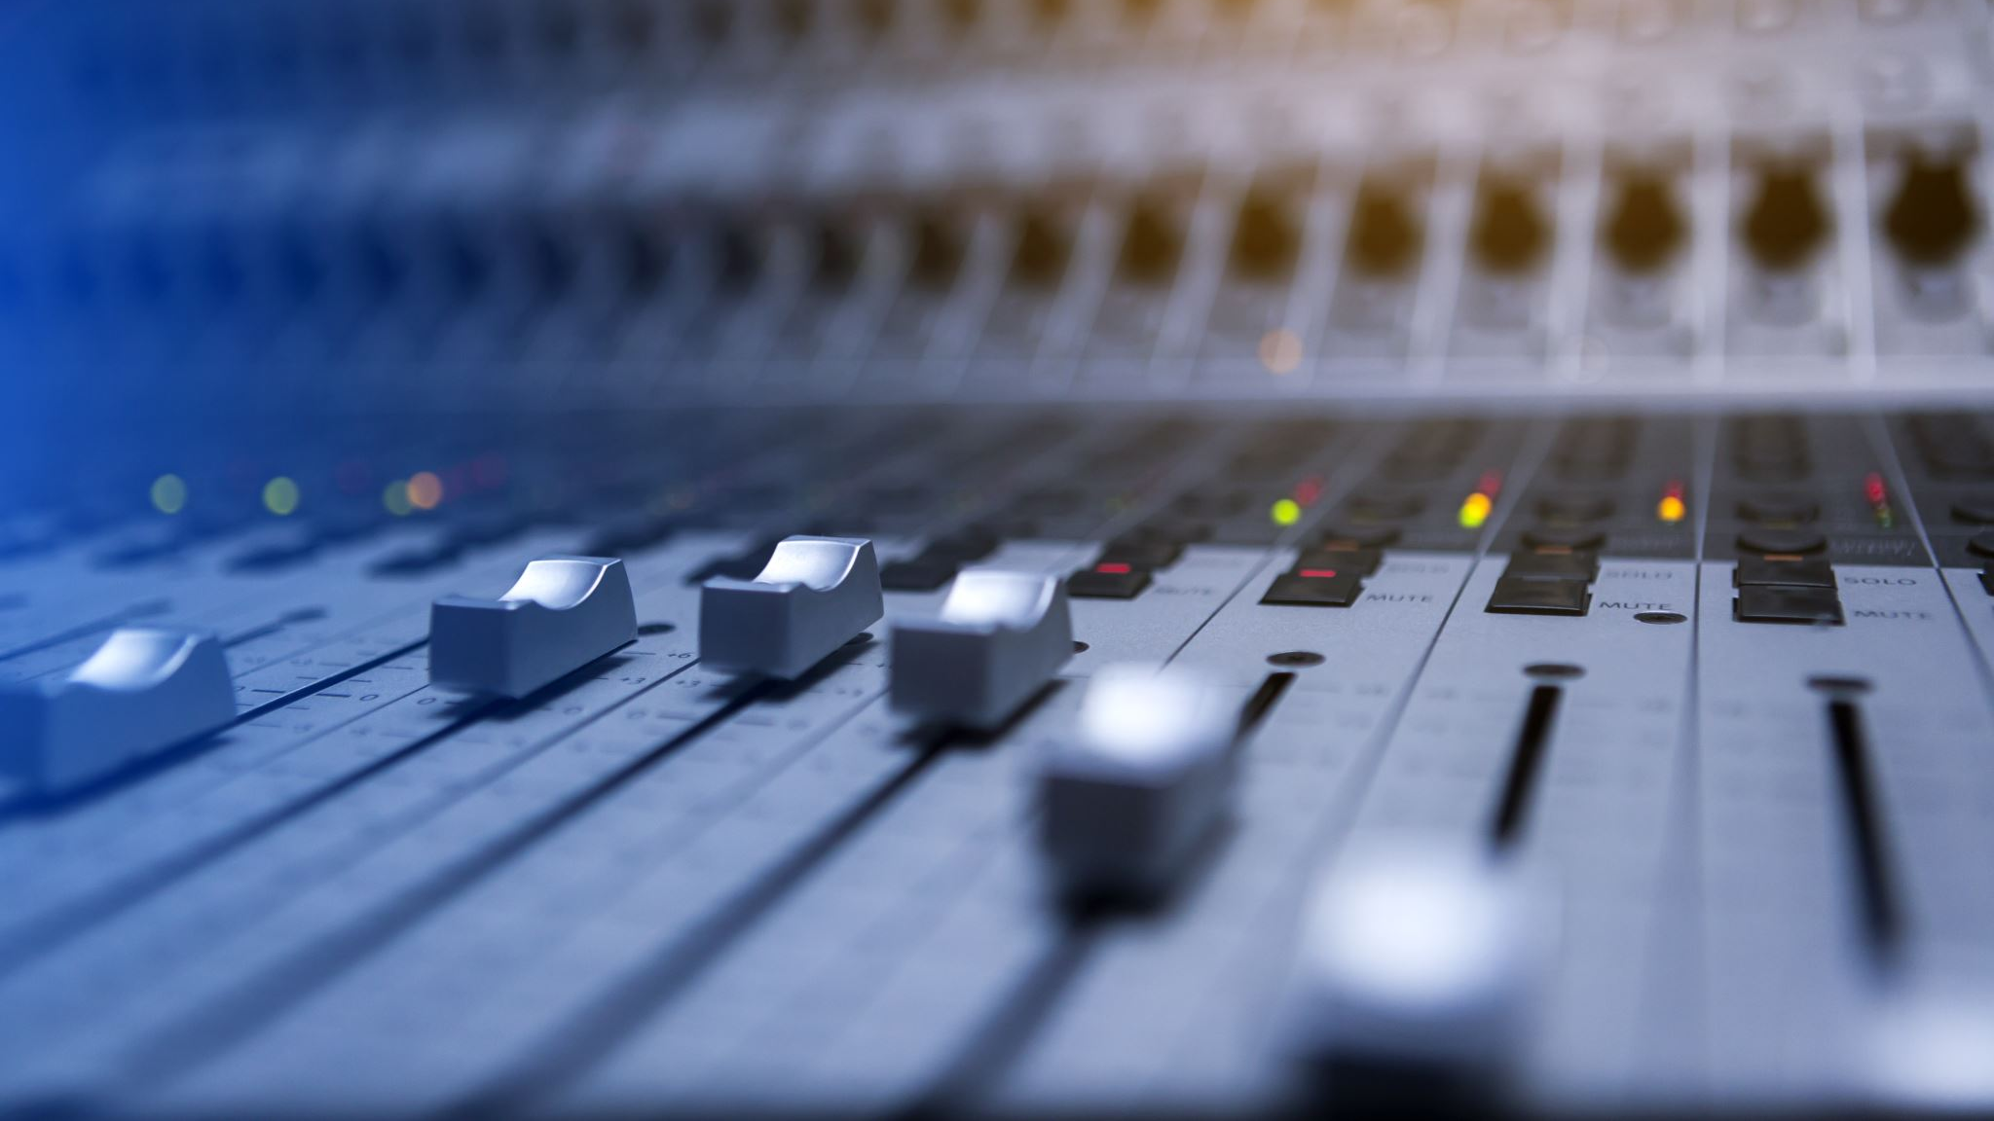
History of Sound Recording
Tomás Echeverri, Santiago Escobar & Antonio baquero

Slide 2
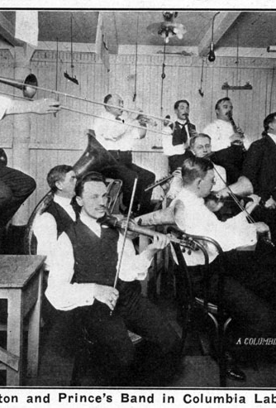
Acoustic Era – Historical Events
The Acoustic Era began in 1877 and it kept on until 1925 (1877-1925)
None of the earlier attempts to record and reproduce sound weren’t possible until the half of the 19th century
The element that introduced this era would be Thomas Edison’s Phonograph, this technological advancement permitted the course of music change forever
Orchestras, band’s and singers would be testers for the use of the object and efficiency, but until confirming how it work and how was the object used.
Years with its function every music group by that time would use it for recording
It opened to a new format for music and to different listeners which would be albums, but that wouldn’t be released until the electrical era
Most music gender used by that time and the one that took to much more recording could be jazz.
The era ended as the creation of microphones which would proceed on to the electrical era.

Slide 3
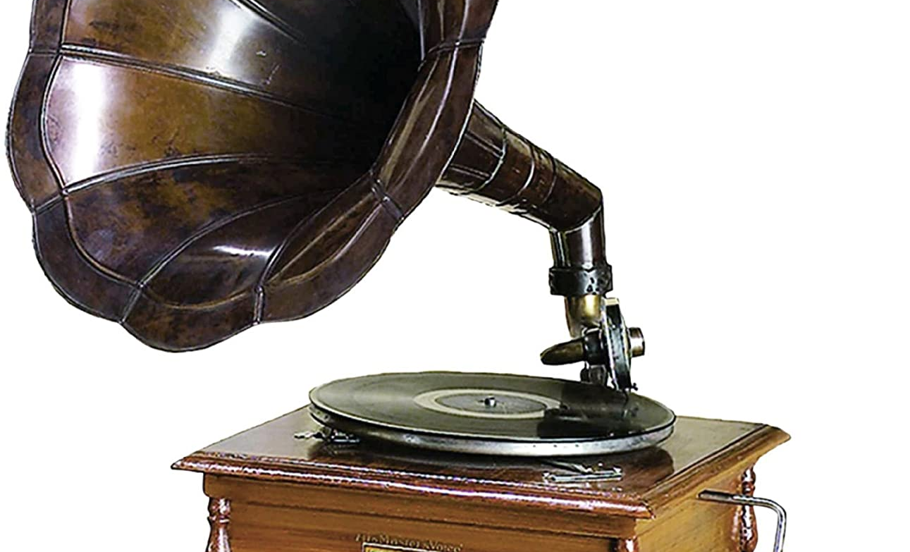
Acoustic Era - Technology
The acoustic era’s technology was based of mechanical devices that carried a large horn in order to capture different sound waves.
Back then music was all mechanic, without the use of microphones or electrical amplification
The two main devices from this era were the phonograph invented by Thomas Edison in 1887 and the gramophone invented by Emile Berliner in 1887
The most obvious features of Edison’s phonogram was a horn with a chronical shape that captured sound waves and a cylinder that was coated with a layer of tinfoil
Sound waves were detected a small diaphragm would vibrate and a needle that was connected to the diaphragm would hit the tin foil and create markings corresponding to each vibration.
The recordings were played back by having the needle follow the grooves that were made initially and pairing the vibrations produced with the air and amplifying the sound produced through the horn

Slide 4
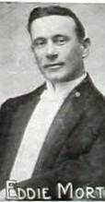
Acoustic Era – Relevant Artists
Enrico Caruso (1873-1920)
He came out to be one of the first artist to use the phonograph to record and perform using it by the 1902’s
Arthur Collins (1864-1933)
was considered as a leading dialect comedy singer, he made part of a popular group at that time called “Peerless Quarter”
Eddie Morton (1870-1938)
He came part of the early recording history, classified and known to be an extraordinary performer.
Billy Murray
Declared to be the most recognized artist from the entire era with over 32 songs to his name, his most recognized song would be “K-K-K-KATY”
Henry Burr (1882-1941)
The second most recognized artist just behind Billy Murray, he made 18 songs through his career, his most recognized song would be “My Buddy”

Slide 5
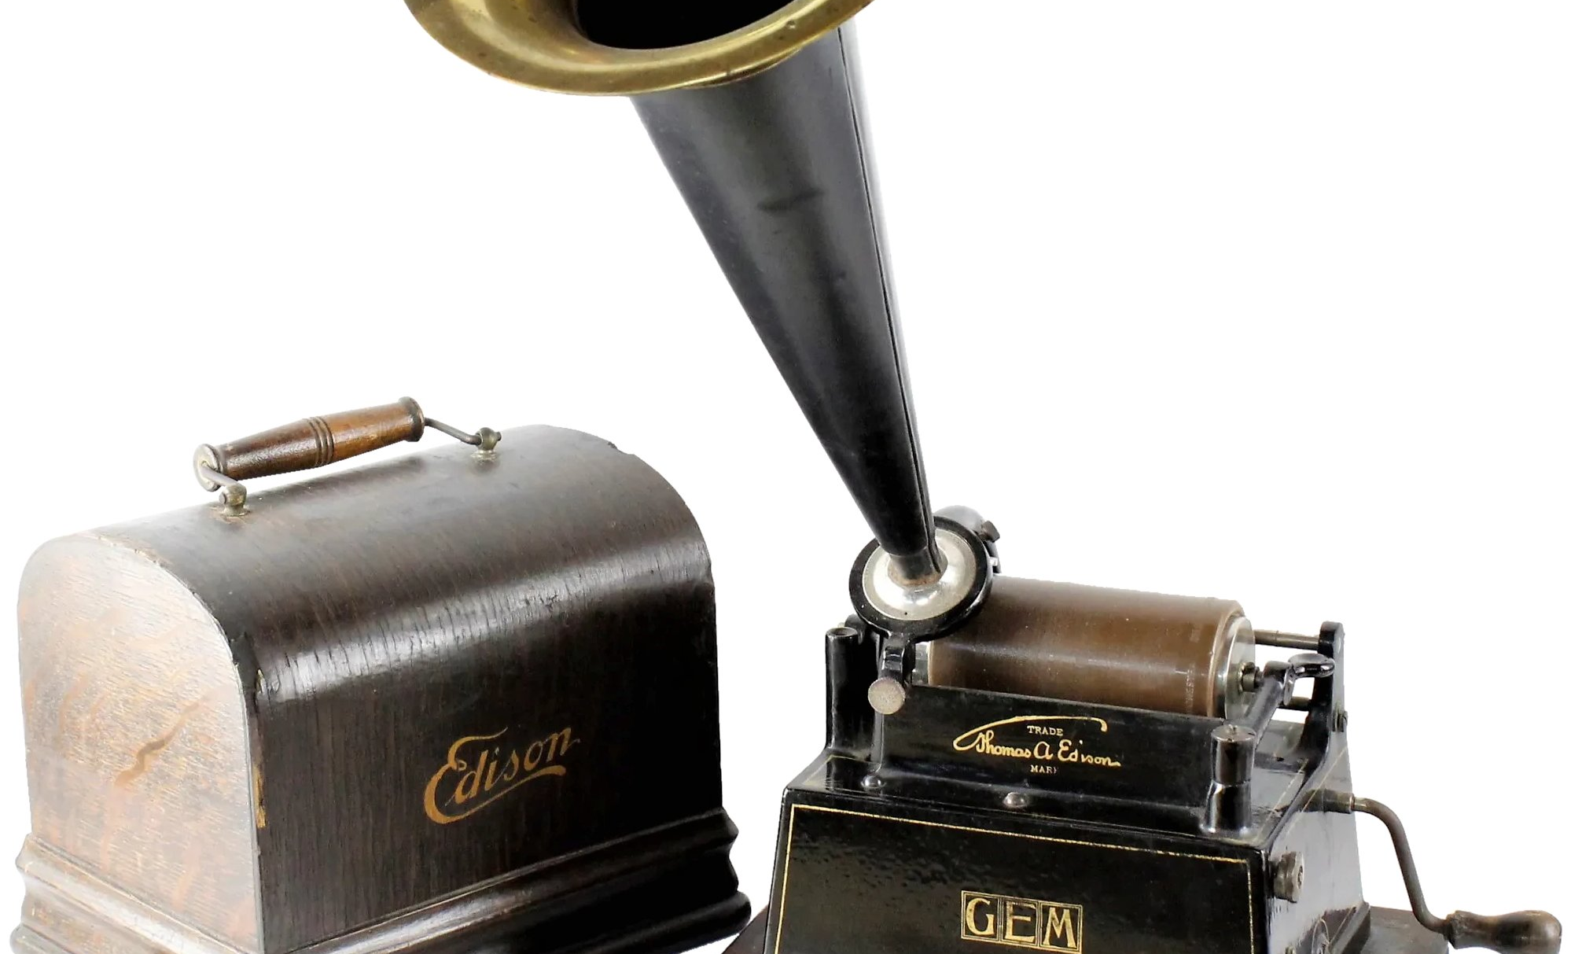
Acoustic Era – Musical Movements
The era opened with the use of pre mechanical recording players which would revolutionize and procced on to what we use and now today of the use of electricity in music
The phonograph opened up to recording performance with different mechanical procedures in order to work
Each sound wave which was located in the construction of Edison would be carefully located inside the place of the recording
With the performance made throw one side, with the horn were they would play and or sing and the crowd at the other listening it would go throw the other side
Instruments and elements were limited for the object to work
Not just only instruments but voices as well as if a performer who recorded really strong or not strong enough would have to be moved away from the mouth of the cone.
The object from. Edison was used as a form of speaker during performances and as well recording

Slide 6
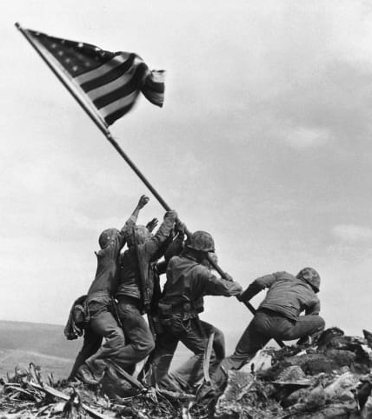
Electrical Era – Historical Events
It lasted from 1925 until 1945
The first electrical functioning technology was sold by The Western Electric company to a record company, the Victor Talking Machine Company which employed it in the recording of the Philadelphia Orchestra performing ‘Danse macabre’.
In august 6 1925, a light emitting vacuum tube that converted audio voltage into variable levels of light to expose movie film created by Edward Wente and his team was introduced to sound on film process business when acquired by Warner Bros.
Publication of The Jazz Singer, first ever movie with sound on produced by the Vitaphone in 1927.

Slide 7
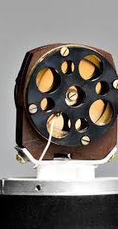
Electrical Era - Technology
The Vitaphone: A sound-on-disc system that allowed for first time people to see and hear moving images simultaneously.
The Condenser Microphone: Invented by Edward Wente, this tool was a microphone that converted acoustic energy into an electrical signal by using charged metal plates that helped generate sound as waves reached the diaphragm.
The Orthophonic Victrola: The first consumer phonograph designed specifically to play electrically recorded phonograph records.

Slide 8
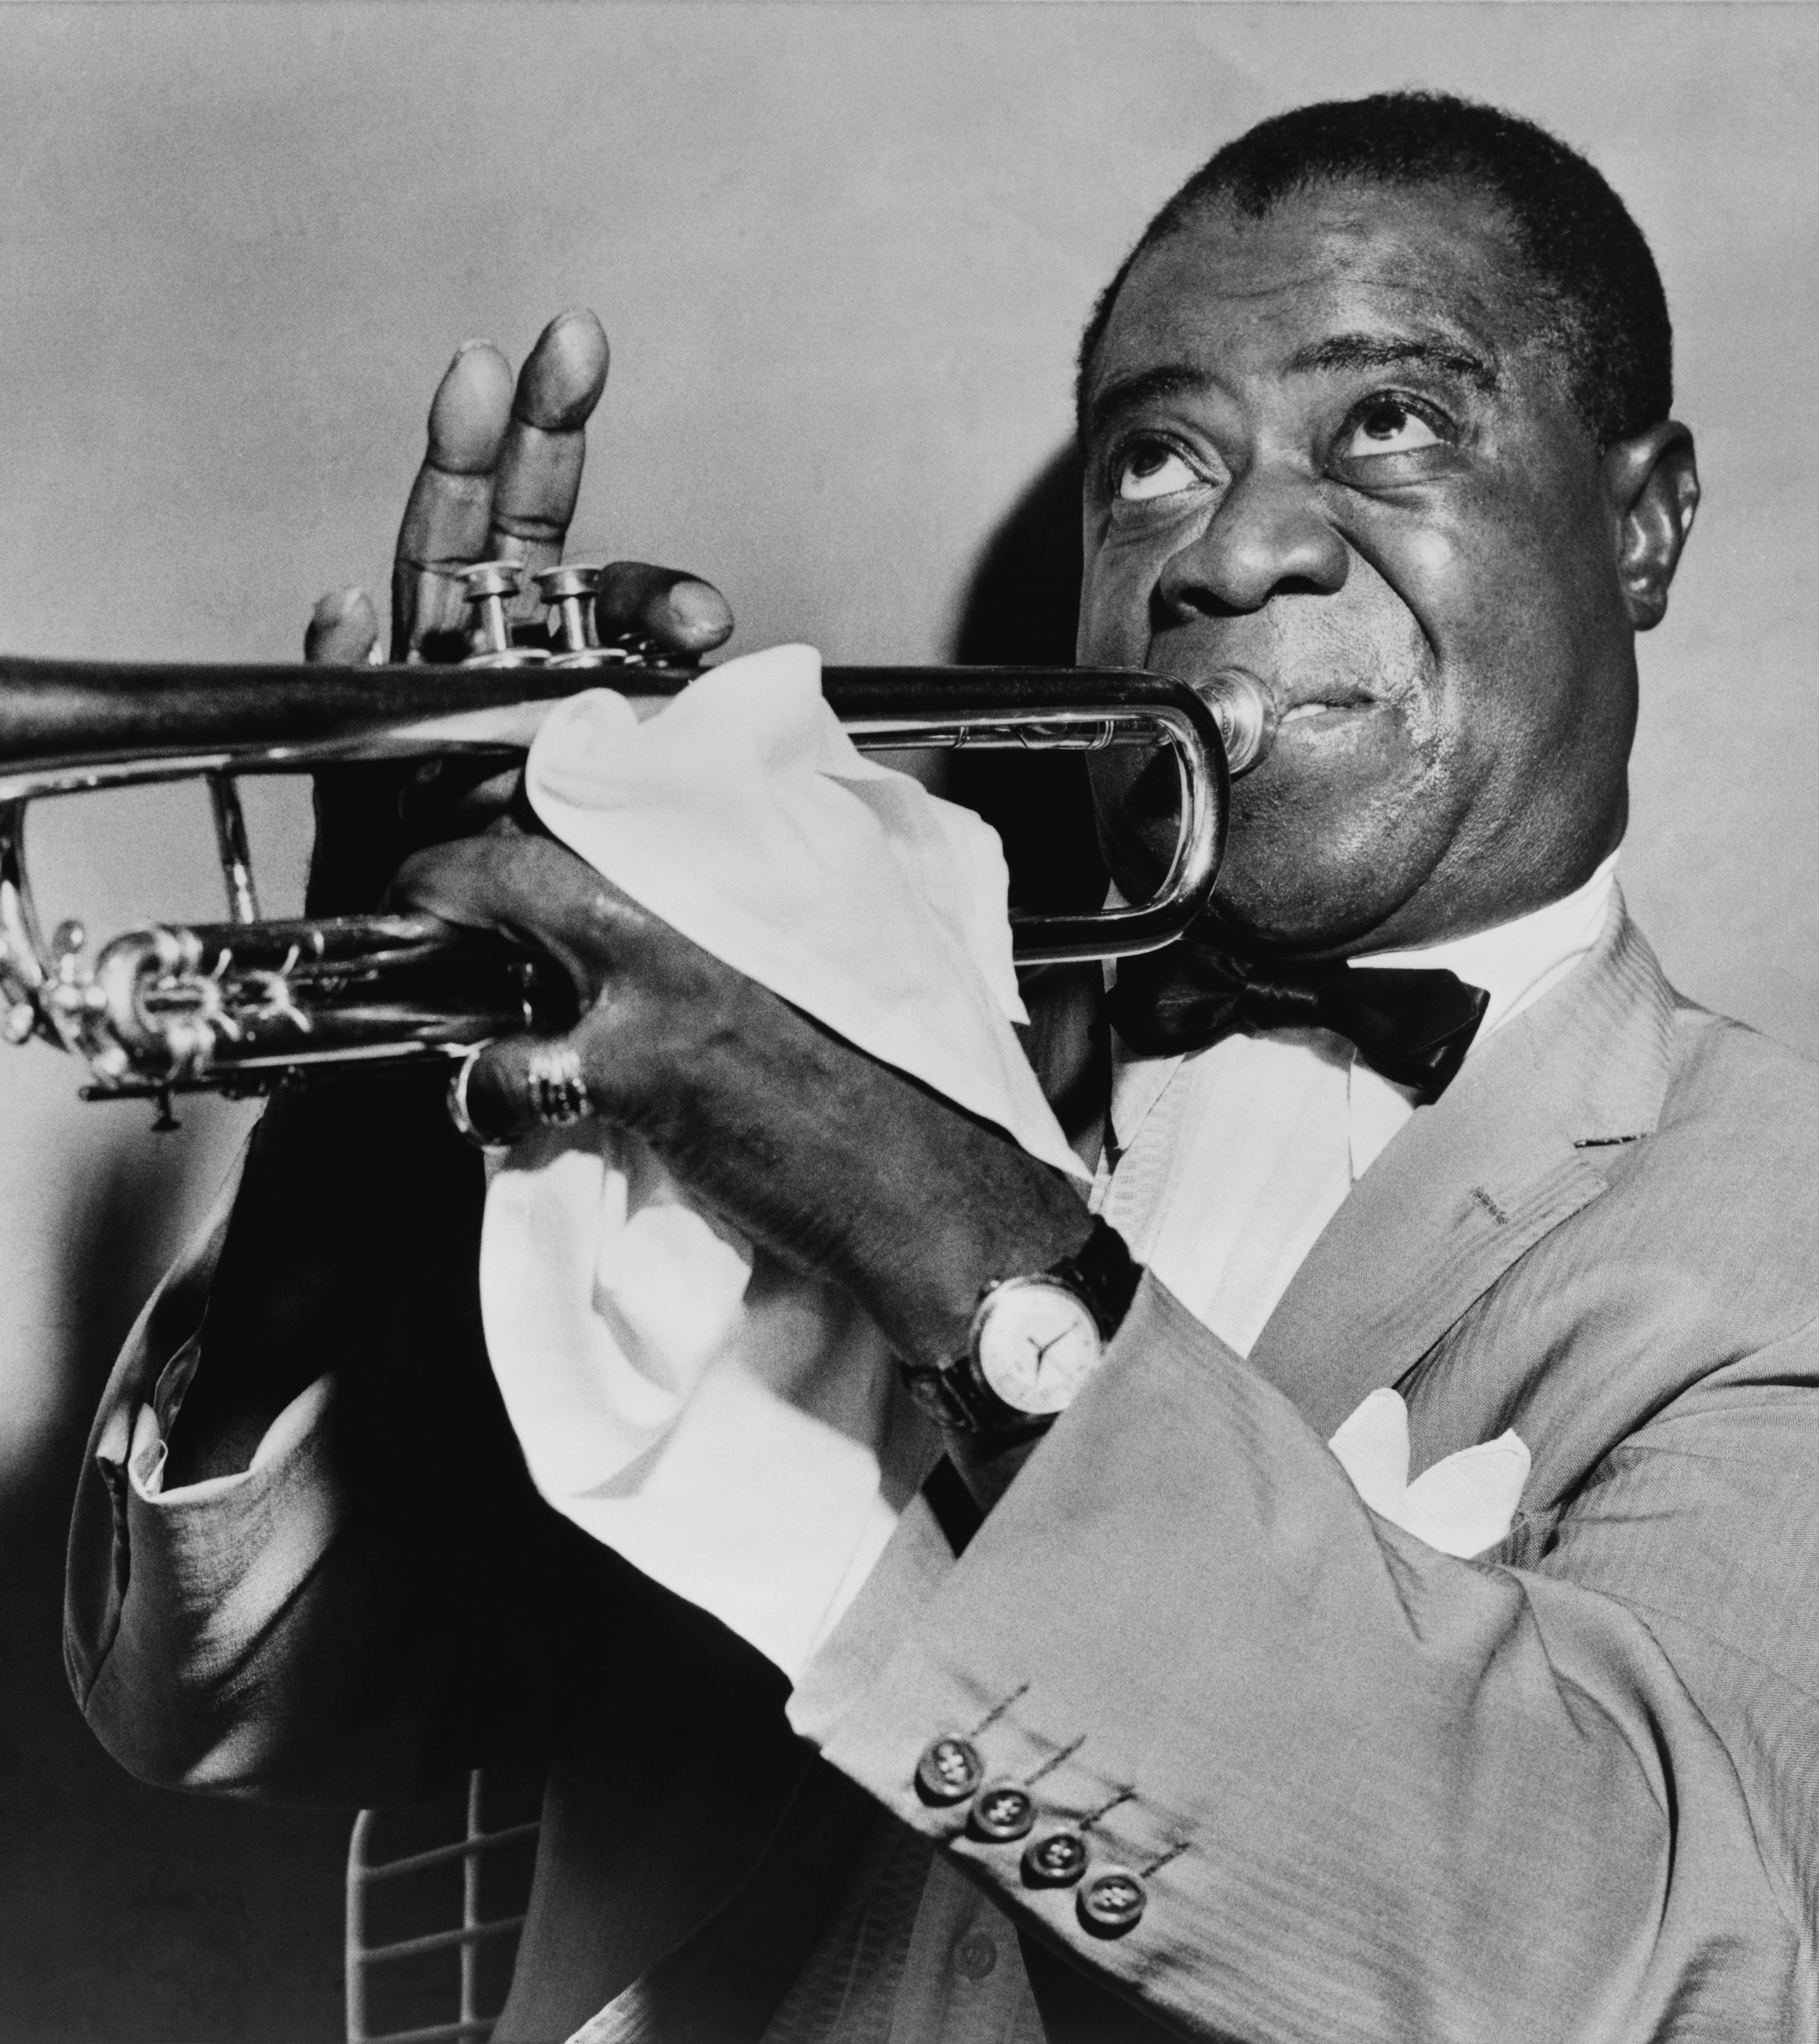
Electrical Era – Relevant Artists
The 1920s had Louis Armstrong, Josephine Baker, Benny Goodman, amongst others.
Then along the 1930s Ella Fitzgerald, Tommy Dorsen, Billie Holiday gained popularity.
The 1940s saw The Andrews sisters, The mills brothers, and many of the same artists from the past decades.

Slide 9
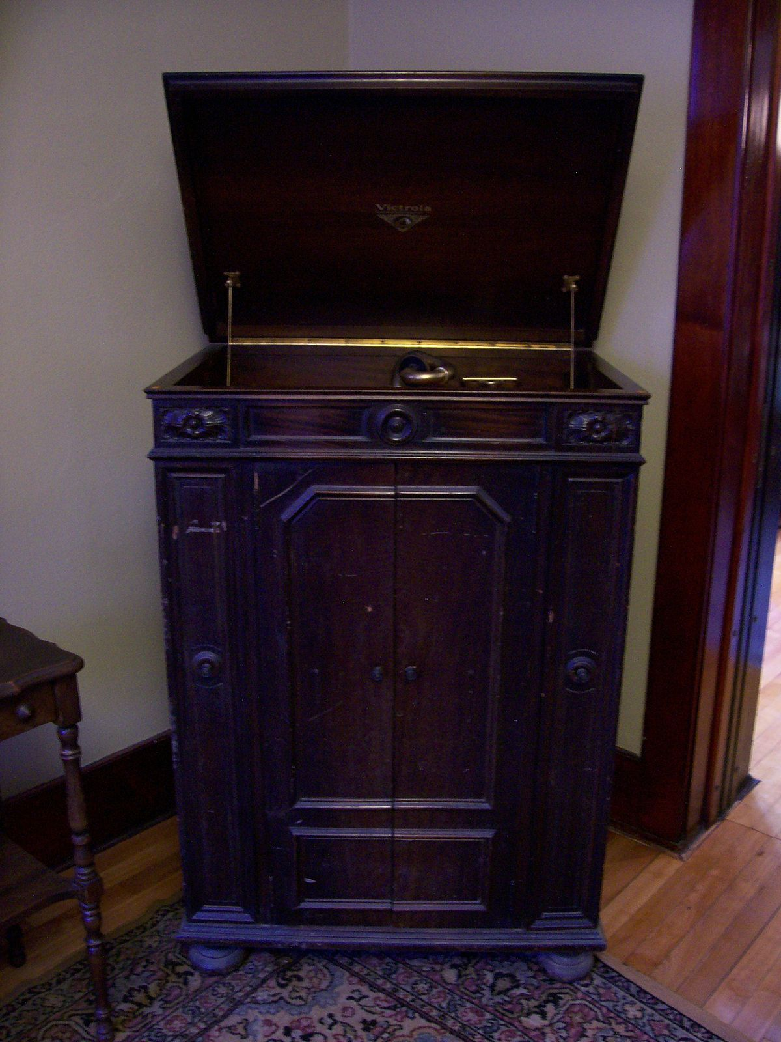
Electrical Era – Musical Movements
This era is mainly divided by two periods and defined by the technique of overdubbing:
First: Before the implementation of the technique of overdubbing, a single mistake during recording messed up it completely. Even though the editing was an option, the sound quality would decrease and in a second take, it was not a guarantee to introduce the sounds at the precise moment.
Second: Overdubbing was sort of the solution since it was a technique that functioned to introduce in audio recording where a passage has been pre-recorded, and then during replay, another part is recorded to go along with the original.

Slide 10
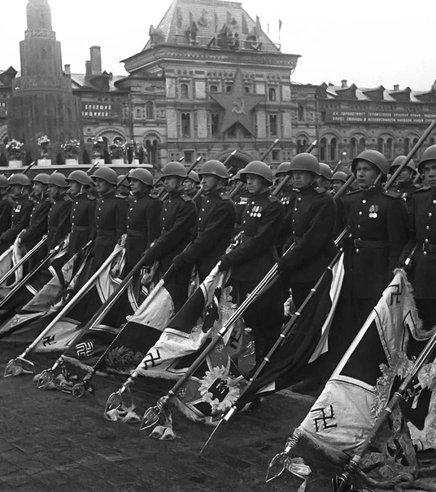
Magnetic Era – Historical Events
The Magnetic Era carried on from 1945 to 1975.
This was the post-war era where all medium term consequences of World War 2 started to show.
The beginning of the Cold War between the United States of America and the USSR.
Sound recording advancements were mostly made in the context of war and not for music. Most of the advancements of this era were thanks to military technology.

Slide 11
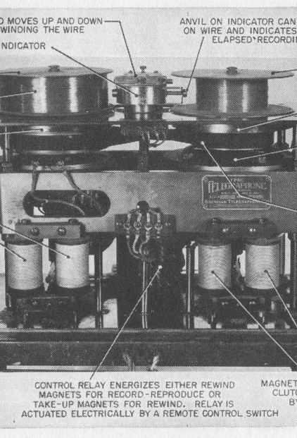
Magnetic Era - Technology
Magnetic recording wasn't exactly new; it started on 1898 with the Telegraphone, however the World Wars brought necessities for armies of both sides: Germans and Americans. To find new ways to intercept enemy telegraph messages.
While the Telegraphone was widely used, a new approach for magnetic communication was found by German engineer Fritz Pfluemer. Who perfected the technology of paper tape.
Based on these advancements the Magnetophone would be created in 1935. It brought many benefits like being portable, having its own speaker and it was much more affordable.
After the war ended, the Magnetophone made its way to the United States and the broadcasting industry.

Slide 12
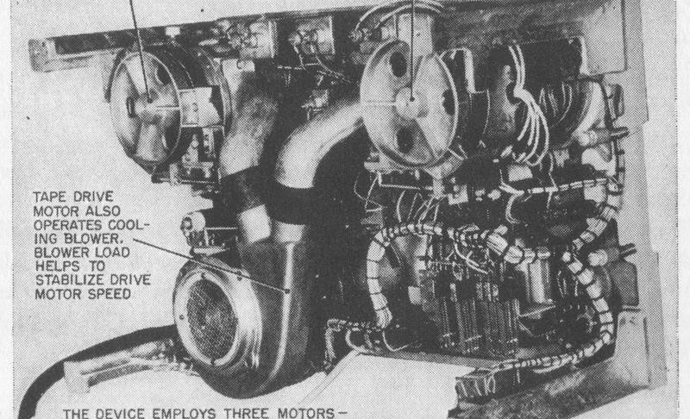
Magnetic Era - Technology – Continued...
The magnetophone was acquired by big companies like ABC that popularized the product and lead to American companies creating their own models. Which lead to the tape-recording industry in America.
Using the German technology of recording tapes, cassette tapes were created for a more convenient way of recording, Introduced by the company Philips.

Slide 13
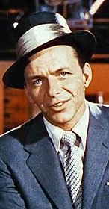
Magnetic Era – Relevant Artists
Bing Crosby and Frank Sinatra were widely popular around the 1940s.
Tony Bennet, Ray Charles, Dean Martin, among others, popularized their music along the 1950s.
Bob Dylan & The Beatles were the most popular along the 1960s.
Elton John, Pink Floyd, Led Zeppelin amongst others entered the industry in the first half of the 1970s.
The most recent artists heavily used cassette tapes to commercialize their music.

Slide 14
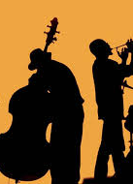
Magnetic Era – Musical Movements
Along the 40s, the most popular musical movements were Swing, Big band, Jazz and Country music.
The 1950s gave birth to rock and roll, rockabilly and continued Country music's popularity.
The 1960s brought movements like British Invasion, R&B, Surf Rock, Roots Rock, Folk Rock, Acappella, and much more.
The 1970s was characterized by Hard Rock, Soft Rock, Funk, Soul, Pop, etc.

Slide 15
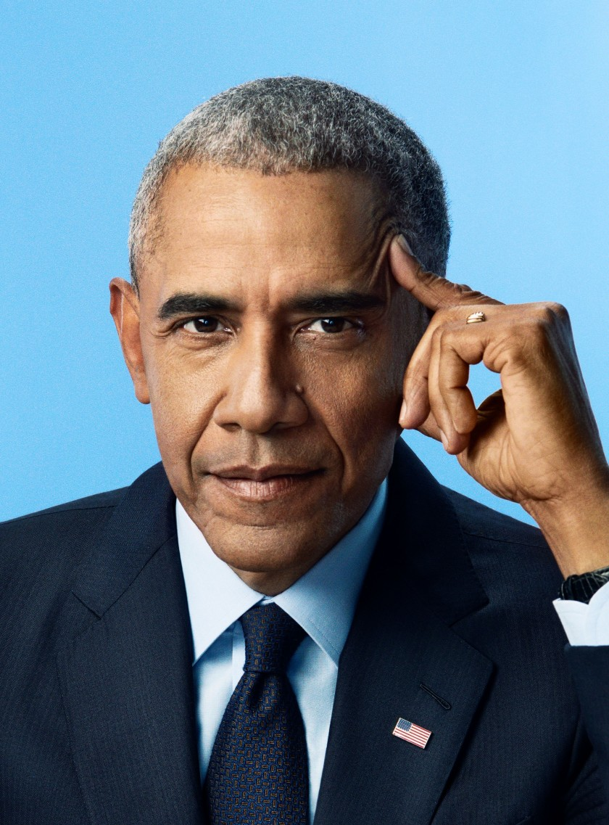
Digital Era – Historical Events
The Digital Era of sound recording started on 1975 and continues to this day.
The 1970s saw the Vietnam war. The first landing on the moon. The creation of the first Apple Computer.
The 1980s saw the Iraq-Iran war. The Titanic. The Falklands war. The explosion of Chernobyl. The creation of Nintendo's Game Boy. The first computer virus.
The 1990s saw the reunification of Germany. Nelson Mandela's activism. The end of the cold war. The creation of the European Union. The dissolution of the USSR. The first flat screen TV.
The 2000s saw the 9/11 terrorist attacks. Apple's iPod. The explosion of internet popularity. Terrorist attacks in multiple first world European nations. First YouTube videos, The release of the iPhone. The Georgian-Russian conflict.
And on the 2010s there was the Brexit, the Black Lives Matter movement, multiple hurricanes and earthquakes that affected Caribbean coasts. Multiple terrorist attacks. Mass shootings.

Slide 16
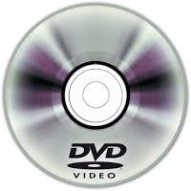
Digital Era - Technology
The first version of the DVD, pioneered by Philips. It allowed for 60 minutes of video and sound. The disc reader used lasers to make the transparent disc shine which created a bitstream that was converted into audio and video.
The CDs were introduced into the global market by 1983. And they were as expensive as $2000 for a CD player. CD sales quickly overtook vinyl sales in the upcoming years and soon enough cassette tapes. This meant even more people had clear sound, longer playtime, and a smaller size than the previous technology.

Slide 17
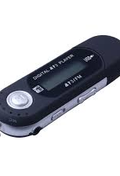
Digital Era - Technology – Continued...
Along the early 2000s digital audio files began to popularize since they had a small file size, and they could easily be transferred.
In 1988 a collective was gathered called the Motion Picture Experts Group. And they created standards for audio encoding. One of which was Layer III, or more popularly known as .mp3 as it entered the internet.
This allowed for music to be decoded illegally and sold through the internet. The MPEG wanted to prevent this and created a variety of new audio encoding layers none of which caught traction and only caused inconveniences when uncompressing audio.
In 1998 the first mp3 player was created which allowed users to listen to their files on the go. People would buy CDs to convert them into MP3 audio files and use them on their devices.

Slide 18
Digital Era - Technology – Continued...
Along 2003 iTunes and Mycokemusic popularized as music sharing online programs. And people did not need to access music by physical copies anymore. And digital downloads gained popularity with even more platforms like Spotify and Pandora.
And on 2014 digital revenue of music overtook physical sales of music.

Slide 19
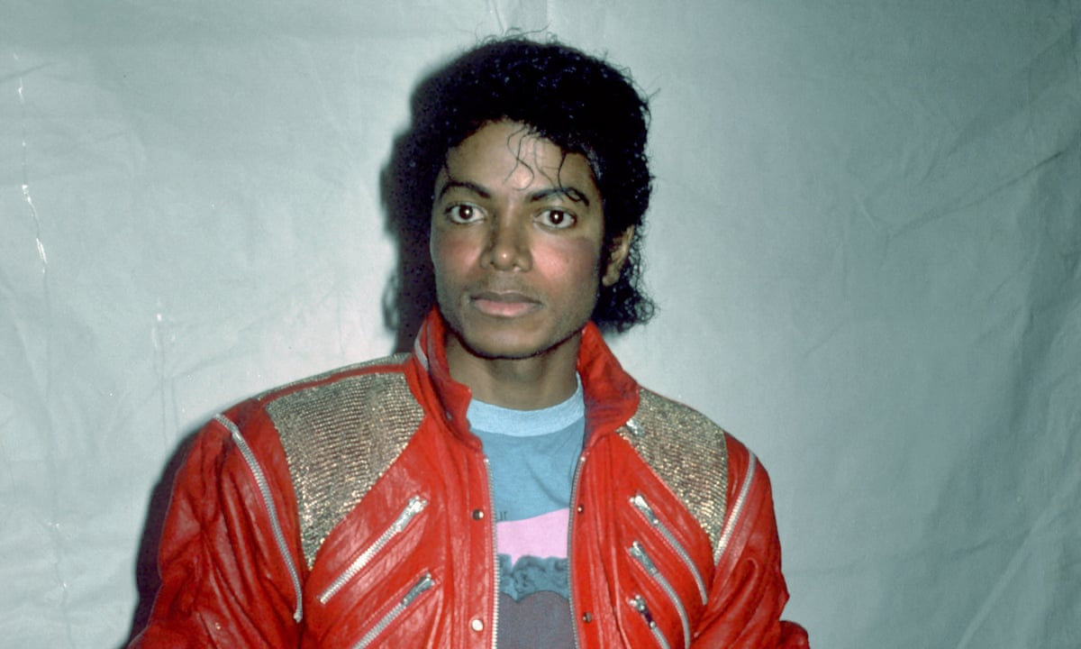
Digital Era – Relevant Artists
Michael Jackson and Madonna were the most popular artists along the 80s.
With the 90s came Mariah Carey, Nirvana, Spice Girls, and others.
The 2000s saw Eminem, Beyonce, Alicia Keys, Jay Z and many others.
Taylor Swift, Drake, Lady Gaga, Ariana Grande, Katy Perry and others grew in popularity along the 2010s.

Slide 20
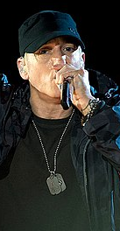
Digital Era – Musical Movements
The 1980s had dance music and new wave.
The 1990s had Hard Rock, Pop Rock, Alternative Rock, and others.
The 2000s saw the rise of Pop, Emo, Garage Rock, Metalcore, etc.
The 2010s had Trap, Rap & Hip Hop.

Slide 21
Kahoot Quiz
Kahoot!

Slide 22
Bibliography
All: The Library of Congress. n.d. Timeline | History | Tools & Resources | National Recording Preservation Plan | Programs At The Library Of Congress | Library Of Congress. [online] Available at: <https://www.loc.gov/programs/national-recording-preservation-plan/tools-and-resources/history/timeline/>
History of Recording. 2020. The Acoustic Era. [online] Available at: <https://historyofrecordingblog.wordpress.com/the-acoustic-era/> [Accessed 23 November 2020].
En.wikipedia.org. 2020. History Of Sound Recording. [online] Available at: <https://en.wikipedia.org/wiki/History_of_sound_recording> [Accessed 23 November 2020].
Murray, B., 2020. Billy Murray - Música, Videos, Estadísticas Y Fotos | Last.Fm. [online] Last.fm. Available at: <https://www.last.fm/es/music/Billy+Murray> [Accessed 23 November 2020].
Stokowski.org. 2020. Development Of Electrical Recording. [online] Available at: <https://www.stokowski.org/Development_of_Electrical_Recording.htm> [Accessed 23 November 2020].
: *Leeson, J., 2017. The Electrical Era. [online] History of Recording. Available at: <https://historyofrecordingblog.wordpress.com/24-2/>

