Slide 1
Fine Arts presentation Our last Chance?
SHARK TANK

Slide 2
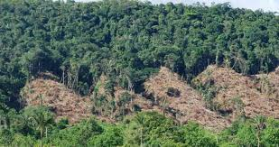
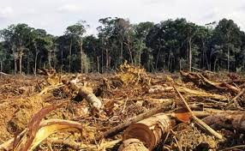
My topic for the exposition:
Deforestation – Environmental Issue inside Colombia

Slide 3
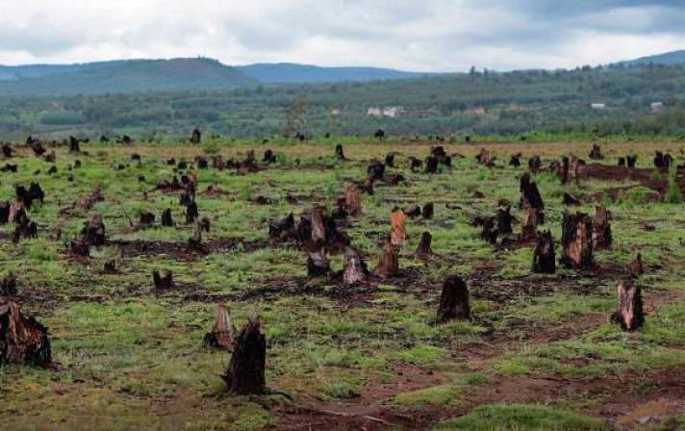
.
ABOUT THE TOPIC:
Colombia is known for being rated as one of the five most deforested countries inside the world. Over the past year around 12 millions of hectares of jungle were destroyed from the past year, that in just only three months, the Amazonia( inside Colombia) was destroyed over 43.000 hectares of jungle, and with all of this stadistics, shown this shows a negative position inside the biodierisity of the country.
HOW DO I FEEL ABOUT THIS?
I think this are crazy amount of stadistic shown that affects not just only the ecosystem but our lives.

Slide 4
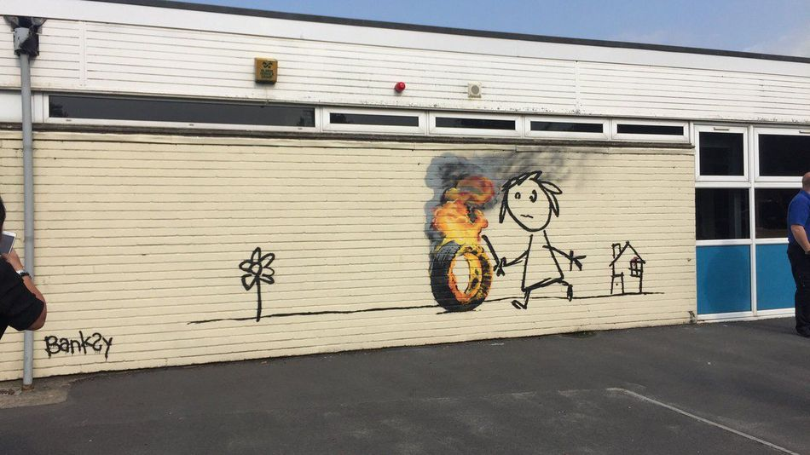
MY REFERENCES:
1st: 2D new form of painting
Bansky,
This guy is known for being a British urban artist which constantly gives out social problematic of society. Bansky seems to always find the correct spaces in which his art can be seen. My idea is to find a certain space inside the school in which it can be publically seen so as the message it is sending.

Slide 5
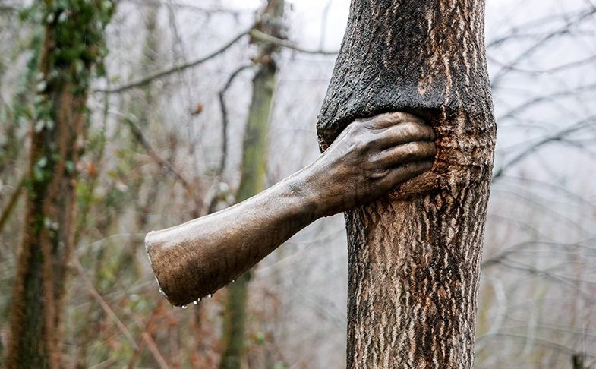
2nd 3D The object uses and transformations
Giussepe Penone
This is an Italian scultural artist that for his work involving the objective transformation with the help of symbols or materials, in the case of the artist he uses trees for his work. I will take this as an example to approach to the symbolism I want and wish to express with this work.

Slide 6
MATERIALS:
Paint spray
Cardboard
Scissors
Papers
Cartoon paper
Stencil paper

Slide 7
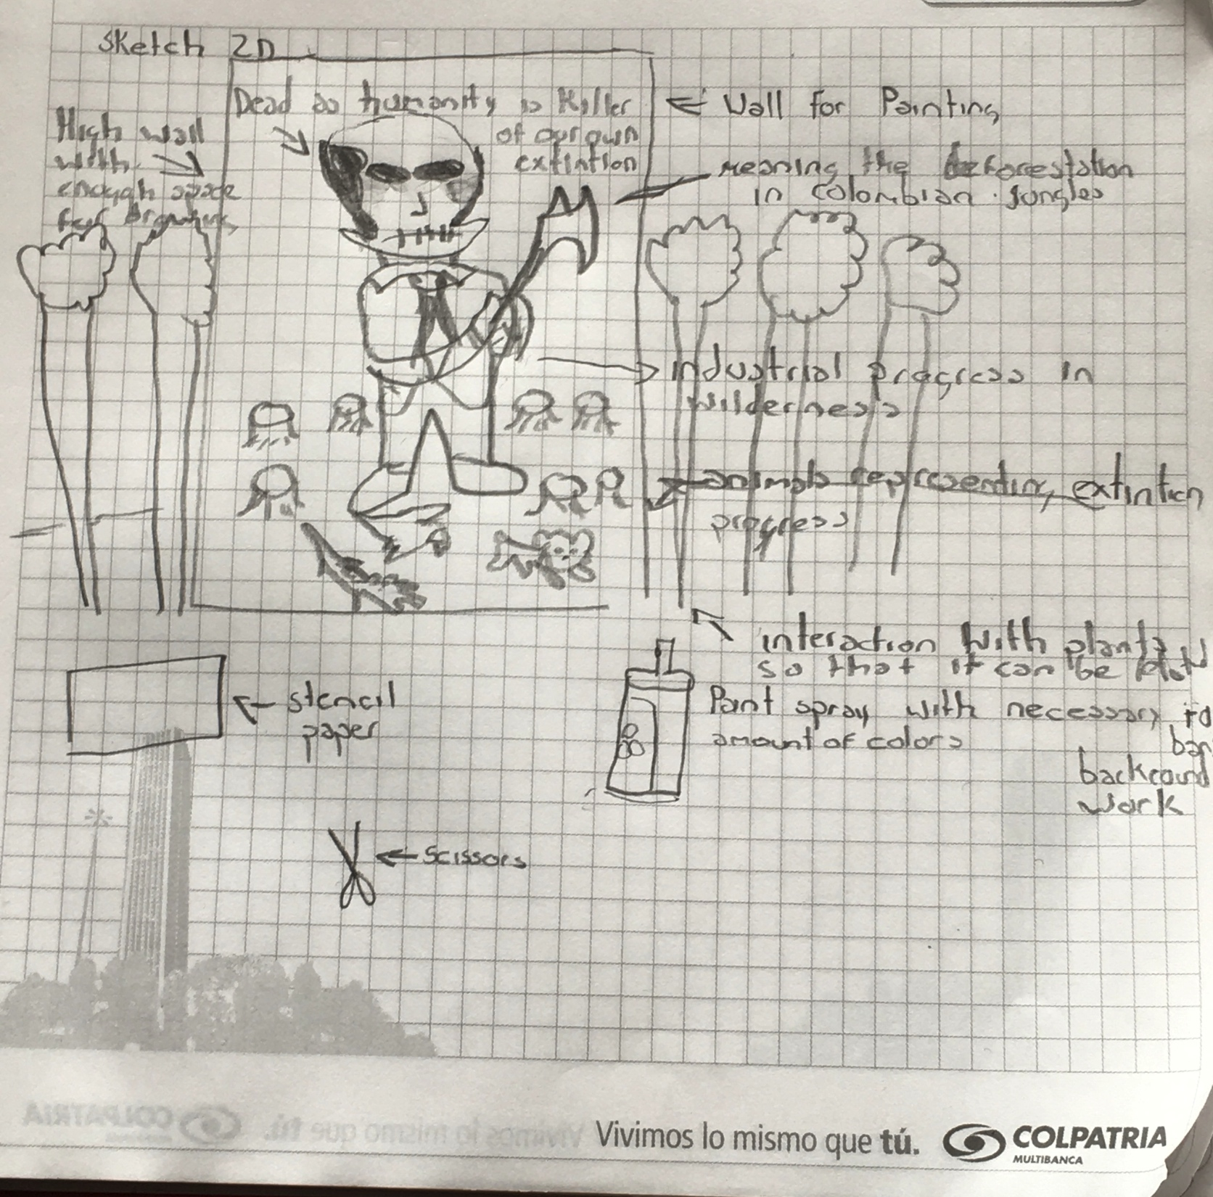
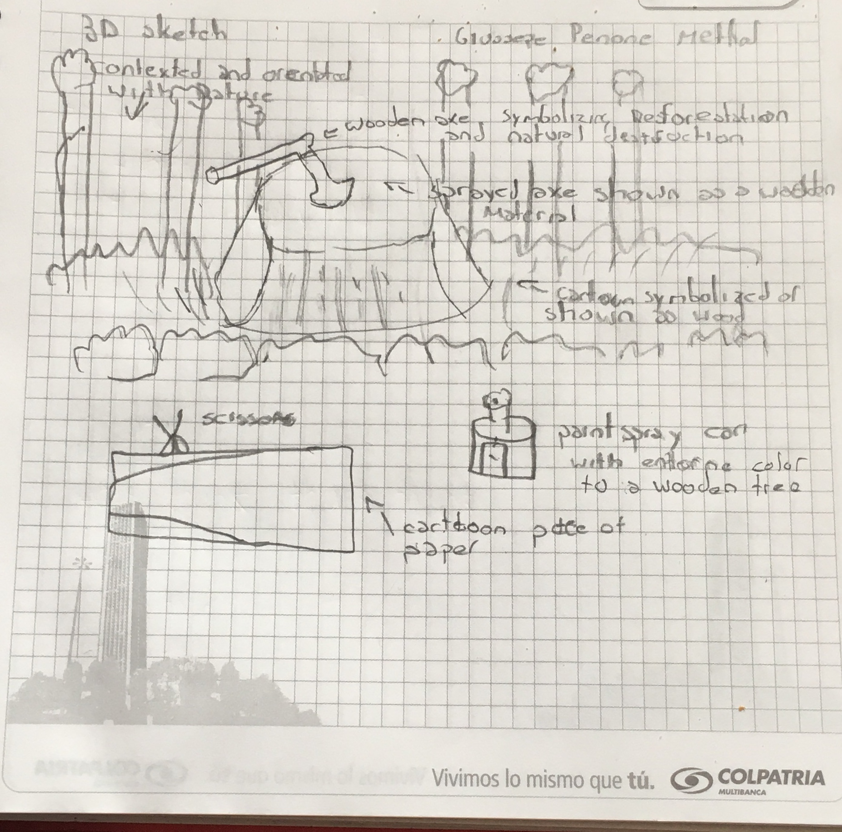
Sketches

Slide 8
How am I exhibing:
My first idea for this work was on to creating an envirormental situation inside Colombia by the perspective of creatures like animals, this will all take place at the art classroom where I will have enough space to show my proyect

Slide 9
WHY AM I DOING THIS?
This is an important poyect for me as it, it can reflects to an global situation that affects everybody ass well with given other people to feel the nature beneath and around them helping create a message for the school and gain awareness of the problem, and transmitted to other people.

