Slide 1
SHARK TANK PRESENTATION
BY: sANTIAGO eSCOBAR

Slide 2
The object
Well, for starters the object that the entire theme of my project will be about castanets. Yes a spanish instruments, but the meaning behind this wood is much more significant, this object belonged to my grandma, Nohra Vargas.
this was givento my father from her before she passed away, it was a difficult time for us, but ever since we kept it as a form of joy and wealth in her memory as she loved dancing and reminds us of all the crazy and lovely things she did while her time was with us.

Slide 3
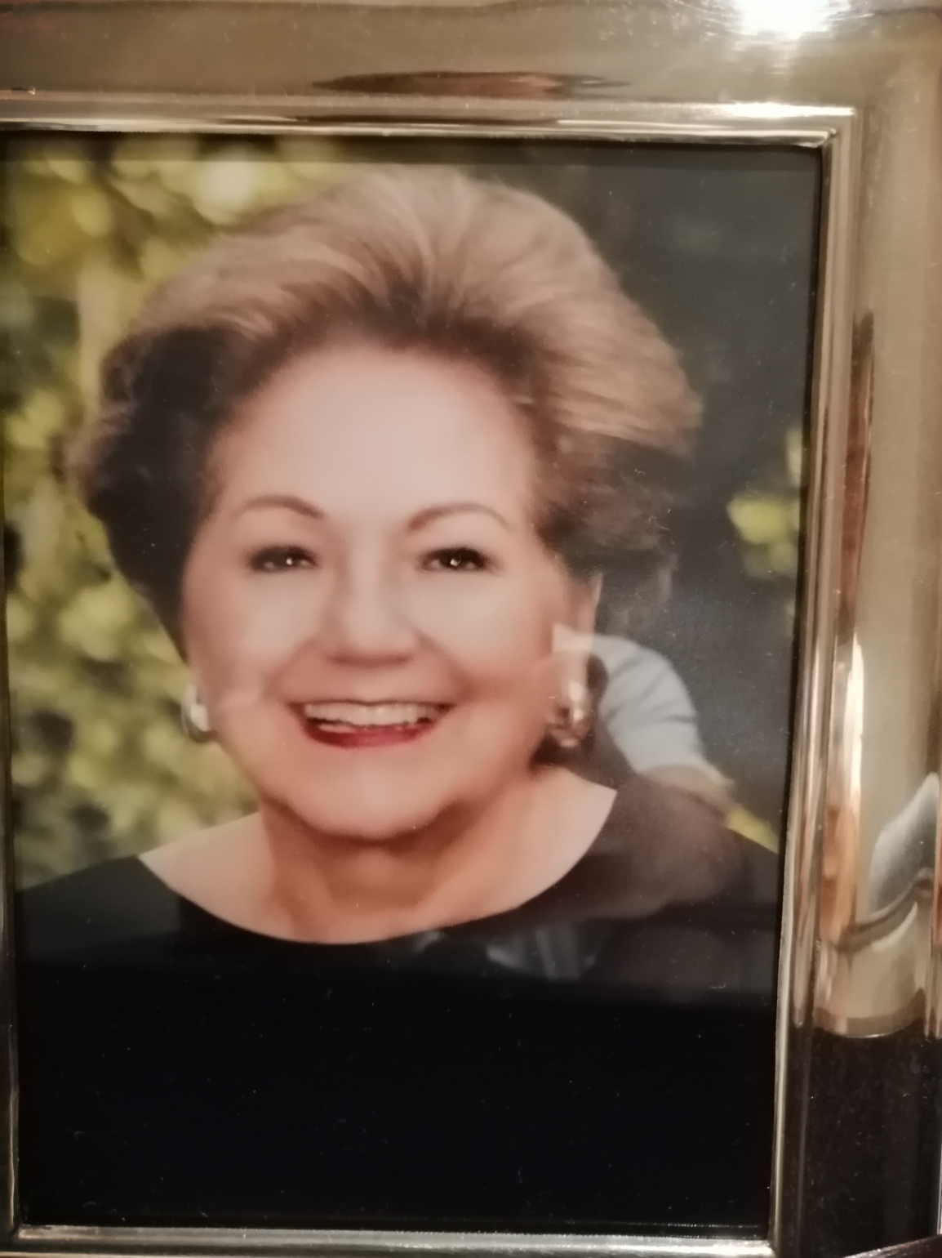
About the person behid the topic
The person behind the object and who the art piece will be dedicated to will be Nohra vargas, My grandma
She was the happiest and the most energetic person that i have ever met, she made
me smile every time that i saw her and made me laugh whenever i talked to her
Her personality was what made our family so alive and united.

Slide 4
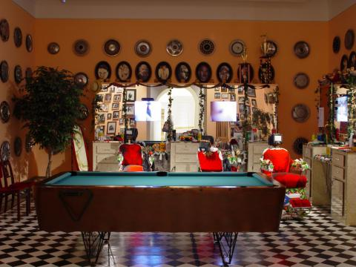
References
Pépon Osorio
REFERNECE
hI IS AN LATIN ARTIST WHO’S MAIN OBJECTIVE IS TO PRESENT different objects and videos in his pieces to portray political and social problems in the Latino community. mY IDEA RELATED TO HIS IS TO SHOW A “GALLERY” WHERE I CAN PRESENT DIFRERENT OBJECTS THAT REFLECT TO MY GRANDMA’S LIFE.

Slide 5
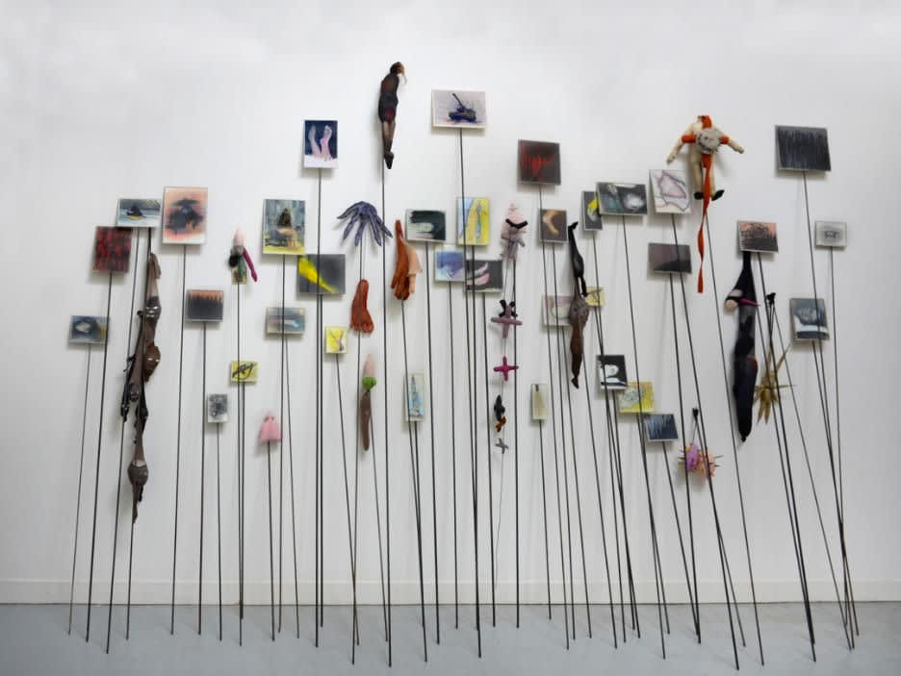
REFERENCES
REFERENCE 2
Annette Messager
she is a French contemporary artist. She is known primarily for her installation work, often including photographs, prints and drawings, and miscellaneous materials. My idea with this is with several objects which she liked is create a heart with all the things she used to like, and will also reflect on to the frases that she usd to say in the ceiling.

Slide 6
The idea to present
The idea for the project to work out would be to show the presence of my grandma by a series of interactions where the specters can aprecieate her way of life and what she standed for.
The first place to look at would be a altar dediacted to her and the objects that belonged to her in order to find her presence in our lives.
The second would be based up from pages from news papers or books hanged up the ceiling where each page has a tipical frase that she used to say.
And the third part will be shown with pictures of our family including her as a form to represent she is still with us.
With the idea, music will be included in order to go with the enviroment.

Slide 7
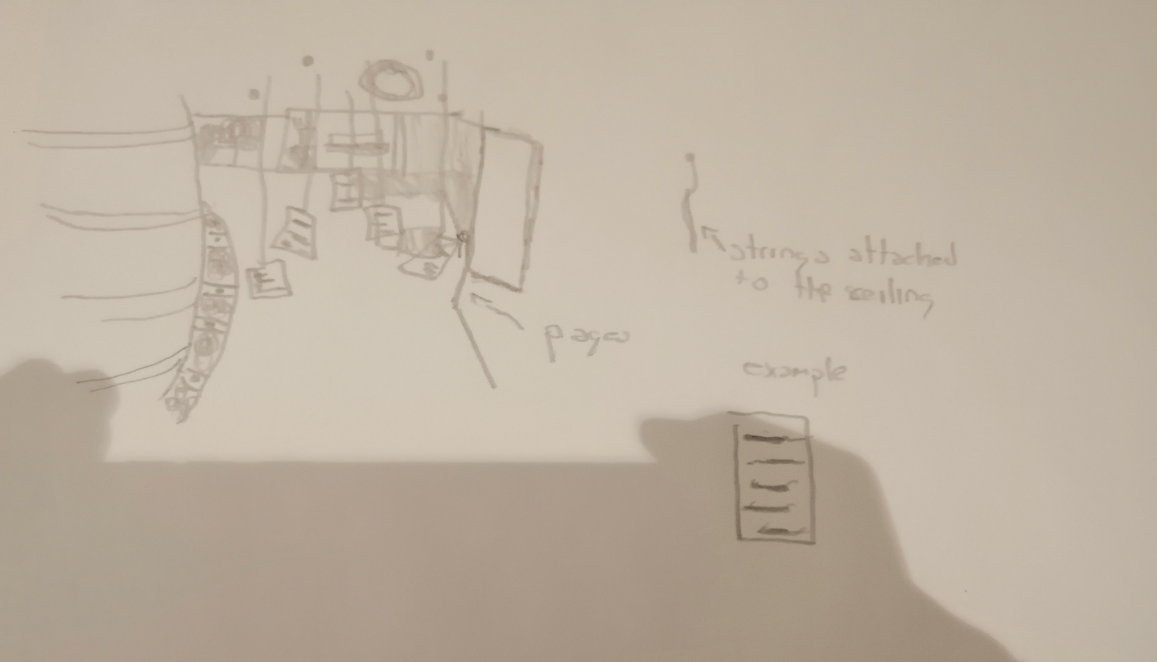
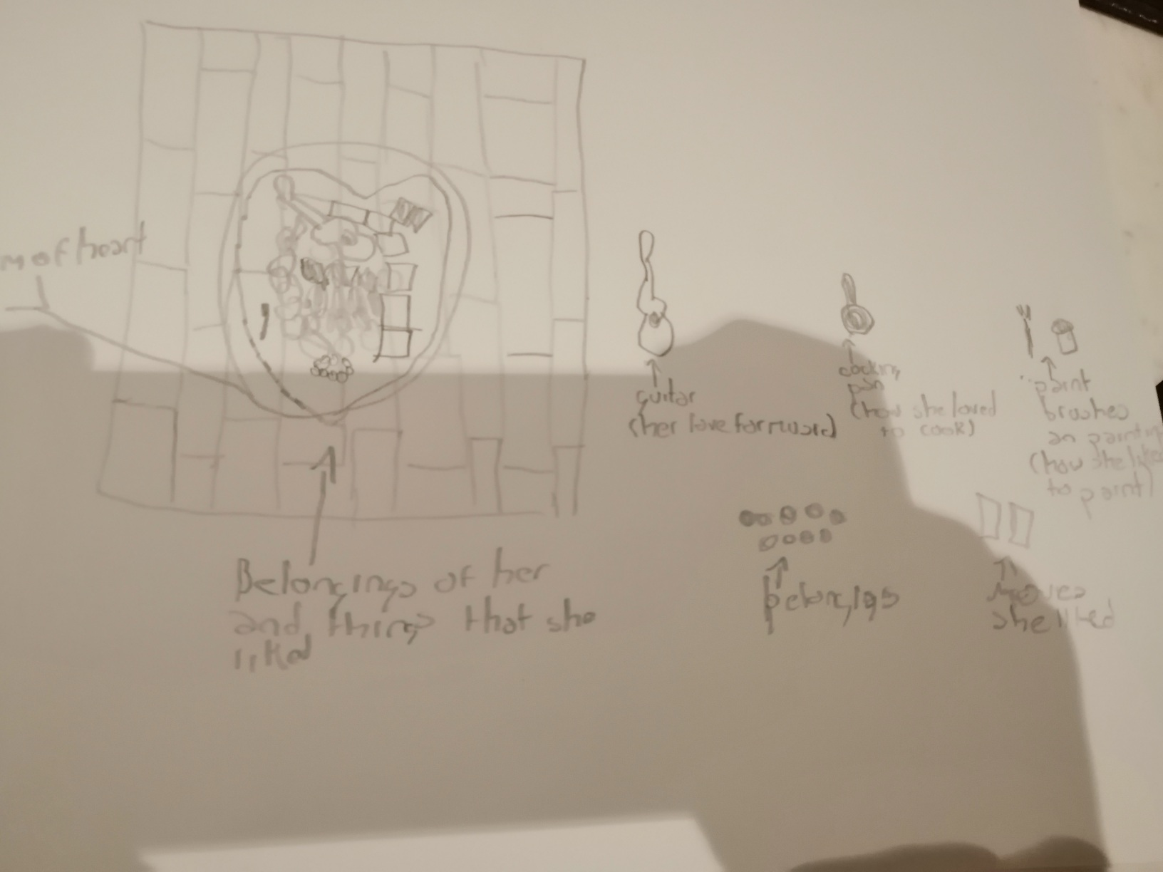
sketches

Slide 8
materials
Elements that belonged to my grandma
Printed images
Newspapers
Sharpees
Something so i could put something in tit
Music
candles

Slide 9
¿why am i doing this?
I want this as it represents the life of my grandma and my true love for her inside my life, it will make me really reflect on how and how much i miss her and how with this things i can still feel her ang hear her, knowing that she is with me, somewhere.

